Slide 1


CS 6831 Designing Secure Cryptography
Tom Ristenpart

Slide 2
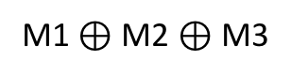

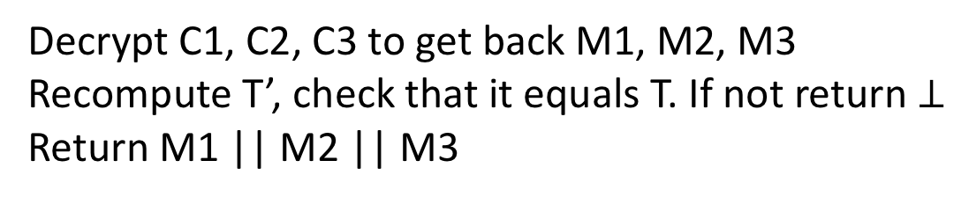


Towards ROR-CCA: OCB
Recall our OCB CPA-core scheme using tweakable block cipher
(assume only allow |M| = 3n):
M1
M2
M3
M1 $⊕$ M2 $⊕$ M3
N is
random
IV/nonce
C0 = N
C1
C2
C3
T
What is decryption algorithm?
Decrypt C1, C2, C3 to get back M1, M2, M3
Recompute T’, check that it equals T. If not return $⊥$
Return M1 || M2 || M3

Slide 3


Proving CTXT requires strong tweakable PRPs
Previous notions for PRP only dealt with CPA attacks
Need TBC’s that resist CCA attacks as well

Slide 4
Proving CTXT requires strong tweakable PRPs
Previous notions for PRP only dealt with CPA attacks
Need TBC’s that resist CCA attacks as well
Luby-Rackoff 3 round not SPRP secure or STPRP secure
Need 4 rounds of Feistel
XE construction not secure either

Slide 5
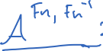
Proving CTXT requires strong tweakable PRPs
Previous notions for PRP only dealt with CPA attacks
Need TBC’s that resist CCA attacks as well
2^{i}
M
T
Important caveat:
Don’t allow tweaking
by i = 0, otherwise attack

Slide 6
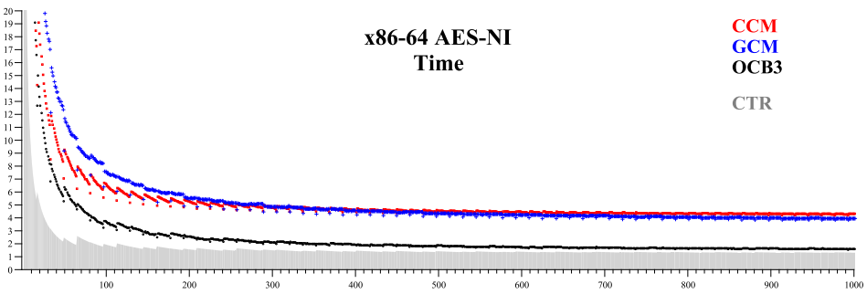
Recap of OCB
We only showed simplified version of algorithm.
Handling non-multiple-of-n messages, choosing z
OCB fastest “single pass” AE scheme in most contexts
Up next: message authentication, generic composition
From [Krovetz, Rogaway 2011]:
Cycles/byte
Message length (bytes)

Slide 7
Another approach: generic composition
OCB achieves AE security via:
block cipher -> tweakable block cipher -> AE
A more conventional view (1990s and 2000s) was:
Block cipher -> CPA encryption
Block cipher (or hash function) -> message authentication
Combine CPA encryption + message authentication

Slide 8


Message authentication schemes
tag(K,M) outputs a tag T
ver(K,M,T) outputs 0/1 (invalid / valid)
Msg, T
K
K
Sender
Receiver
Correctness: ver( K, M, tag( K, M ) ) = 1 with probability 1 for all K,M
Message authentication codes (MACs):
tag is deterministic
ver( K, M, T ) = ( tag(K,M) = T )

Slide 9

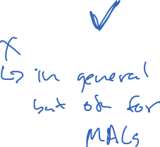
Unforgeability under chosen-message attack (UF-CMA)
Security: No computationally efficient attacker can forge tags for a new message, even given chosen message attack
Why no verification oracle?
Strong UF-CMA (SUF-CMA) gives multiple verification attempts
SUF-CMA => UF-CMA ?
UF-CMA => SUF-CMA ?

Slide 10

PRFs are good MACs
Let F be good PRF for some suitable message space
Associated MAC:
tag(K,M) = F(K,M)
ver(K,M,T) = ( F(K,M) = T )
Then this MAC is UF-CMA:

Slide 11
Building PRFs
Ciphertext block chaining (CBC)
Pad message M to M1,M2,M3,... where each block Mi is n bits
Choose random n-bit string IV
Then:
M1
M2
M3
IV
E_{K}
E_{K}
E_{K}
C0
C1
C2
C3
Can we convert this into variable-message-length PRF?

Slide 12
CBC-MAC
M1
M2
M3
IV
E_{K}
E_{K}
E_{K}
Fix IV to constant
value, i.e., IV = 0^{n}
T
Turns out this is (provably) a good PRF
if K used only on same-length messages
Notes:
http://blog.cryptographyengineering.com/2013/02/why-i-hate-cbc-mac.html

Slide 13
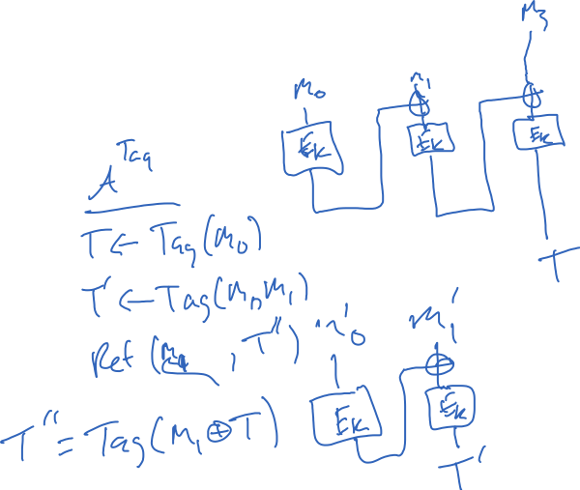
Breaking variable-input-length CBC-MAC
Allow any messages of length a multiple of n
Notes:
http://blog.cryptographyengineering.com/2013/02/why-i-hate-cbc-mac.html

Slide 14
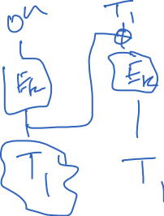
Breaking variable-input-length CBC-MAC
Allow any messages of length a multiple of n
Notes:
http://blog.cryptographyengineering.com/2013/02/why-i-hate-cbc-mac.html

Slide 15

Encrypted CBC-MAC (ECBC-MAC)
M1
M2
M3
Run output of CBC-MAC through separately-keyed block cipher call
E_{K1}
E_{K1}
E_{K1}
E_{K2}
T
Intuition:
last blockcipher call “hides” internal state of CBC-MAC, which is enough for security
Notes:
http://blog.cryptographyengineering.com/2013/02/why-i-hate-cbc-mac.html

Slide 16


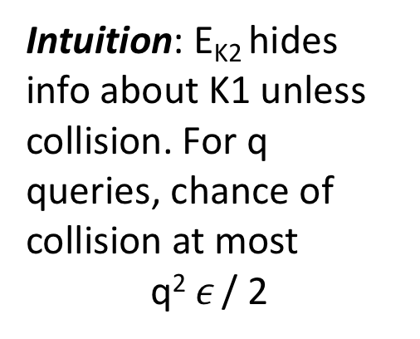
Universal hash then PRF approach
Turns out this is a good construction for any H that is a (computational) universal hash function
M
H_{K1}
E_{K2}
T
Intuition: E_{K2} hides info about K1 unless collision. For q queries, chance of collision at most
q² $ε$ / 2
Notes:
http://blog.cryptographyengineering.com/2013/02/why-i-hate-cbc-mac.html

Slide 17
Universal hash then PRF approach
Turns out this is a good construction for any H that is a (computational) universal hash function
M
H_{K1}
E_{K2}
T
Computational almost universal (cAU)
Now can limit to computational adversaries
Intuition: E_{K2} hides info about K1 unless collision. For q queries, chance of collision at most
q² $ε$ / 2
Notes:
http://blog.cryptographyengineering.com/2013/02/why-i-hate-cbc-mac.html

Slide 18
Universal hash then PRF approach
M
H_{K1}
E_{K2}
T
Computational almost universal (cAU)
Notes:
http://blog.cryptographyengineering.com/2013/02/why-i-hate-cbc-mac.html

Slide 19

Generic composition
Combine CPA-secure scheme with a UF-CMA MAC
(1)
M
Several ways to combine:
(1) encrypt-then-mac
(2) mac-then-encrypt
(3) encrypt-and-mac
K1
Enc
MAC
K2
C
T
(3)
M
(2)
M
M || T
K1
Enc
MAC
K2
K1
Enc
MAC
K2
C
T
C

Slide 20

Generic composition
(1)
M
Several ways to combine:
(1) encrypt-then-mac
(2) mac-then-encrypt
(3) encrypt-and-mac
K1
Enc
MAC
K2
C
T

Slide 21
Proof sketch
Recall: ROR + CTXT => ROR-CCA
ROR trivial (MAC is over ciphertext)
CTXT implied by UF-CMA of MAC
Build UF-CMA adversary from CTXT-adversary by simulating SE encryption
Winning conditions for CTXT and UF-CMA compatible, so elementary wrapper works

Slide 22
Key separation is critical. Using same key with CBC-Mode + CBC-MAC:
M1
M2
IV
E_{K}
E_{K}
C0
C1
C2
T
E_{K}
E_{K}
E_{K}
This is insecure!

Slide 23
TLS 1.2 record protocol: MAC-Encode-Encrypt (MEE)
Padding is not MAC’d.
Implementations must
handle padding checks
very carefully.
SQN +
comp method
Payload
MAC
Payload
MAC tag
Padding
Enc
Header
Ciphertext
MAC
HMAC-MD5, HMAC-SHA1, HMAC-SHA256
Encrypt
CBC-AES128, CBC-AES256, CBC-3DES, RC4-128

